Slide 1
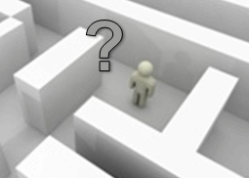
Indoor Localization – Todays and Future Applications
Mobile Internet Technology Seminar
David Schunke
Seminar Talk, Juli 2013

Slide 2
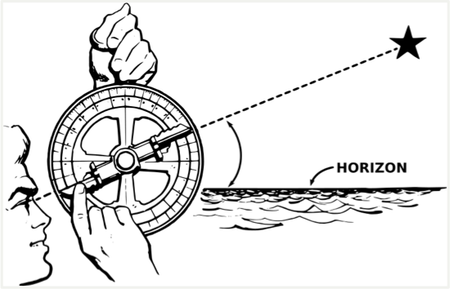
Motivation
Why indoor localization?
Outdoors: GPS
Line of sight required
Accuracy up to few meters
Indoors: GPS not feasible
No line of sight
Typically high accuracy required
Challenges
What are the requirements of my application?
What system do I need?
Notes:
First I want to give a motivation of the topic.
So why is indoor localization interesting and where is the difference to outdoor localization?
Well, in outdoor scenarios, there exists a state-of-the-art system namely GPS.
GPS can achieve an accuracy of few meters, but it requires a line of sight.
The difference in indoor scenarios is, that there exists no line of sight due to walls and roofs.
This makes GPS for indoor scenarios not feasible.
In indoor scenarios also it is a high accuracy required because of the tight structure of buildings where just a few meters could mean a totally different room for example.
So there is kind of a demand for an accurate state-of-the-art indoor localization system.
The challenges in indoor location aware applications are currently:
What requirements has my application
And what system is fullfills them?

Slide 3
Outlook
Technologies
Localization Techniques
Use Cases
Requirements
Example Applications
Conclusion & Future Prospect
Notes:
Here is an overview of the following points.
First we talk about the technical background of localization.
Then about some use cases and their requirements.
And I will show some example applications of indoor localization.

Slide 4
Technologies
Mechanical waves
Ultrasound
Bound to a medium (air, water)
Electromagnetic waves
Radio waves (e.g., Wi-Fi, Bluetooth, UWB)
Light
Infrared
Not bound to a medium
Sensors
Accelerometer, Compass
Notes:
So for localization, we first need some kind of information source about the target.
This could be a mechanical wave like ultrasound for example.
The important attribute of mechanical waves is, that their propagation is bound to a medium like air or water.
Without a medium, mechanical waves can not propagate as they are based on pressure.
Other possible sources are electromagnetic waves, such as radio waves like Wi-Fi signals, light or infrared.
Electromagnetic waves are not bound to a medium and could also propagate in vacuum.
And they travel with the velocity of light, so much faster than mechanical waves.
Other possible information sources are sensors, like accelerometer or a compass.
These are possible carriers to obtain some information.

Slide 5
Localization Techniques
Transform source technology to valuable information
Received signal strength (RSS)
Signal strength is proportional to travelled distance
Also usable as pure data
Time of arrival (ToA)
Leads to a distance
Time difference of arrival (TDoA)
Leads to a distance
Angle of arrival (AoA)
Leads to an angle
Notes:
But to actually get a valuable information about the target from a wave for example, we need to do something with it.
One possibility is to use a receiver that records a wave and measures the signal strength level.
The signal strength level of a wave is proportional to the travelled distance following the inverse-square law.
Thus the received signal strength holds information about the distance between the transmitting source and the receiver.
So the measurement could be converted to a distance or even be used as pure information.
Another possibility is to use the time of arrival also called time of flight.
In this technique, a transmitter emits a signal and a receiver records it.
By using the time when the signal has been emitted and the time the signal has been recorded, together with the propagation speed of the signal, a distance can be calculated.
In this method, both transmitter and receiver have to be highly time synchronized as small deviations in the system time would quickly lead to notable errors.
The third is called time difference of arrival.
Contrary to ToA, in this method are used two signals with different propagation speeds.
The receiver then records both signals and with again the propagation speed and the difference in time when both signals have been recorded, a distance is estimated.
Another one is the angle of arrival or also called direction of arrival.
In this method, an angle from the receiver to the transmitter is calculated.
This could be done by directional hardware or using an array of antennas that record the same signal.
And then again from the time difference and the well known distance between the antennas, an angle can be estimated.
So we finally have some information about the target either a distance, an angle or even some pure information like the signal strength value.

Slide 6
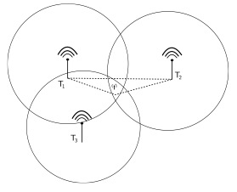
Localization Techniques
Two types of methods
Deterministic
Trilateration / Triangulation
Multilateration
Fingerprinting
Sensors (accelerometer, compass)
Probabilistic
Likelihood ratio theory
Statistical methods (e.g., HMM, PF)
Further statistical models and optimizations to increase accuracy
Notes:
These information can the be used to calculate a location.
Localization methods can be divided into to types.
There are deterministic such as trilateration, angualtion, multilateration, fingerprinting or sensor based.
Trilateration uses the distance of three receivers to the target that in best case intersect in one point which then is the search location.
Triangulation uses angles, multilateration uses hyperbolids and four measured tdoas.
Fingerprinting uses e.g. a map of signal strengths of the environment and then compares the measured RSS value to the map.
From sensors e.g. from an accelerometer, the values could be transformed to e.g. steps of a human and then using the direction from a compass and the source location to estimate the new location.
The other type are probabilistic method.
The difference is, that deterministic methods estimate in best case a single location, where probabilistic methods calculate probabilities for all locations based on the information.
The location with the highest probability is then the final location.
For example for trilateration I said that in best case the intersection contains of a single point.
However there are influences on waves and imprecisions in the calculating processes so that the intersection could result in an area of multiple locations.
This could be optimized using further statistical models such as movement patterns or other methods to determine the best of the resulting points.

Slide 7
Use Cases
Some possible applications are…
Indoor navigation
Also with position related information (e.g., museum)
Inventory monitoring
Surveillance
Assistance in disaster scenarios
Smart home
And many more…
Notes:
So we have seen how the process of calculating the location could be done.
Now I want to give some ideas for what such an indoor localization system could be used.
A typical application is indoor navigation, so for example in large buildings this could help people to find designated destinations.
Or even serve further information to the surroundings like in a museum information to a painting a person is standing in front of.
It could also be used to monitor your inventory so you know where your devices are and even as a surveillance system to track people.
Such a system could also be helpful in disaster scenarios like after an earthquake or in a burning building to find people.
And it could be also used for convinience in smart home to automatically adjust different things like temprature or light to peoples locations.
But in fact there are many many other possible use cases for an indoor localization system.
As you see, some are comparable like the in surveillance and disaster scenarios, both system could be used to estimate the location of people.

Slide 8
Requirements
Application | Device oriented | Target interaction | Real-time
Navigation | yes | yes | yes
Inventory monitoring | yes | no | no
Surveillance | no | no | yes
Disaster scenarios | no | no | yes
Smart home | no | yes | yes
Notes:
And here is a short overview of some possible requirements and applications compared to each other.
So possible requirements are if the system is device oriented like in navigation where a device is used to finally display the location information.
Or if interaction of the target in the localization process is available, e.g., in smart home, where the person could some how interact with the system via gestures for example.
And the third one that is listed here if the application requires real time localization or if localization from time to time is sufficient.
So in this table we see requirements of the applications can be very different.
Like smart home and inventory monitoring.
But again we see, that surveillance and disaster scenarios have similar requirements, thus a surveillance system could maybe also be used in disaster scenarios or vice versa.
So a system could be used for multiple applications, but we already see, building an overall system for every application is pretty hard if not impossible.

Slide 9
Further Requirements
Environment compatibility
Radio signals eventually not feasible in a hospital
Ultrasound not feasible in a factory
Cost factor
Reduction of employment amount
Integration in an existing infrastructure
E.g., Wi-Fi, WSN
Hardware restrictions
E.g., only rely on common sensors in a smartphone
Notes:
Here are some further possible requirements.
So there could be restrictions through the environment, e.g., radio signals could be forbidden in a hospital as they could interfer with some medical equipment.
Or in a factory where the sound level is pretty high, ultrasound could become not feasible.
The cost of a system, the installation and the maintanance could be important, e.g, the system shall reduce the amount of employees.
A requirement could be that it should be integrated in an existing infrastructure like a wireless network.
Or even that the system is restricted to specific hardware like the common sensors in a smartphone.
All these points could become requirements for an application so that in the end the application that defines the requirements finally defines the design of the localization system.

Slide 10
Examples
Access points as data collectors
Relies on a Wi-Fi infrastructure
Uses signal strength from wireless network traffic
Only software-based
Application:
Hand out information material of a course only to participants that are present in a specific room

Slide 11
Examples
Home entertainment system
Relies on UWB
Uses reflection from human body
Requires additional hardware
Application:
Adjust volume level to a persons position
Gesture control

Slide 12
Examples
Self-contained indoor navigation
Relies on smartphone
Uses different sensors
Accelerometer
Compass
Additional calibration by an activity based map
E.g., elevators, stairs
Targets environments without an existing network infrastructure
Application
Navigation in the parking garage at Munich airport

Slide 13
Conclusion & Future Prospect
Conclusion
Use cases have different requirements
Not all technologies feasible in every use case or environment
Different possible approaches for same application
Use case defines system design
Future prospect
Systems that rely on existing hardware stand out
Amount of location aware applications increase
No overall indoor localization system possible

Slide 14
Thanks for your attention!

